Slide 1
GIS BASED EMBAKEMENT AND FLOOD ALERT METHODS

Slide 2
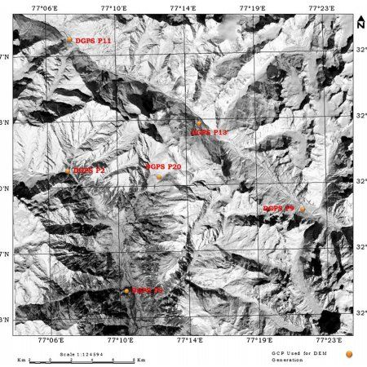
Collection of GCPs

Slide 3
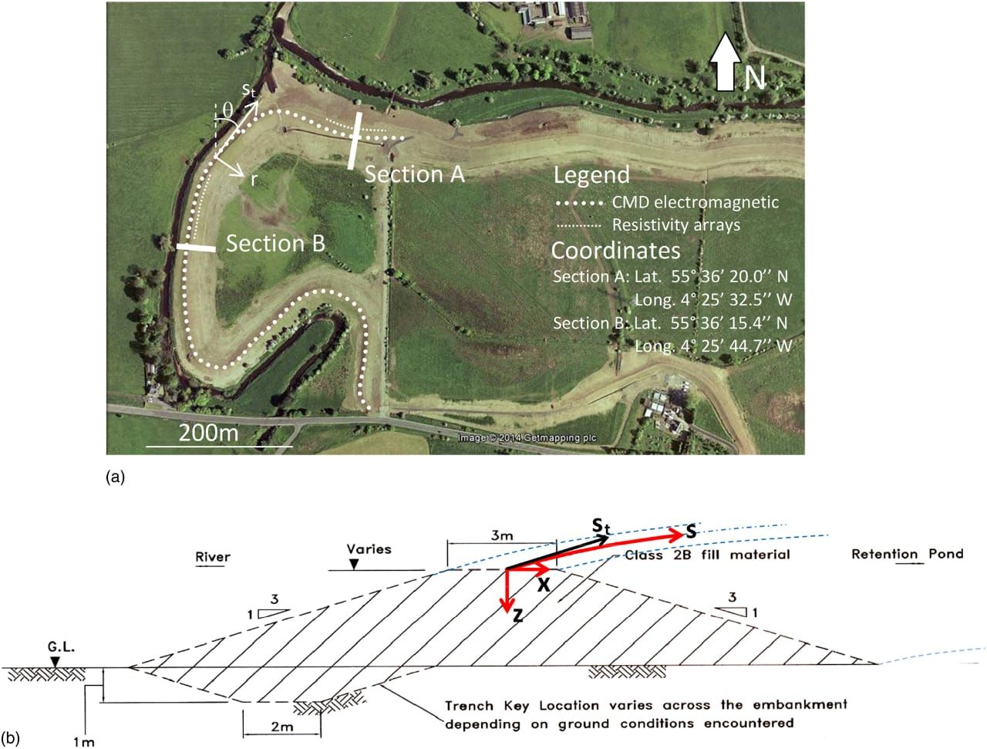

Slide 4
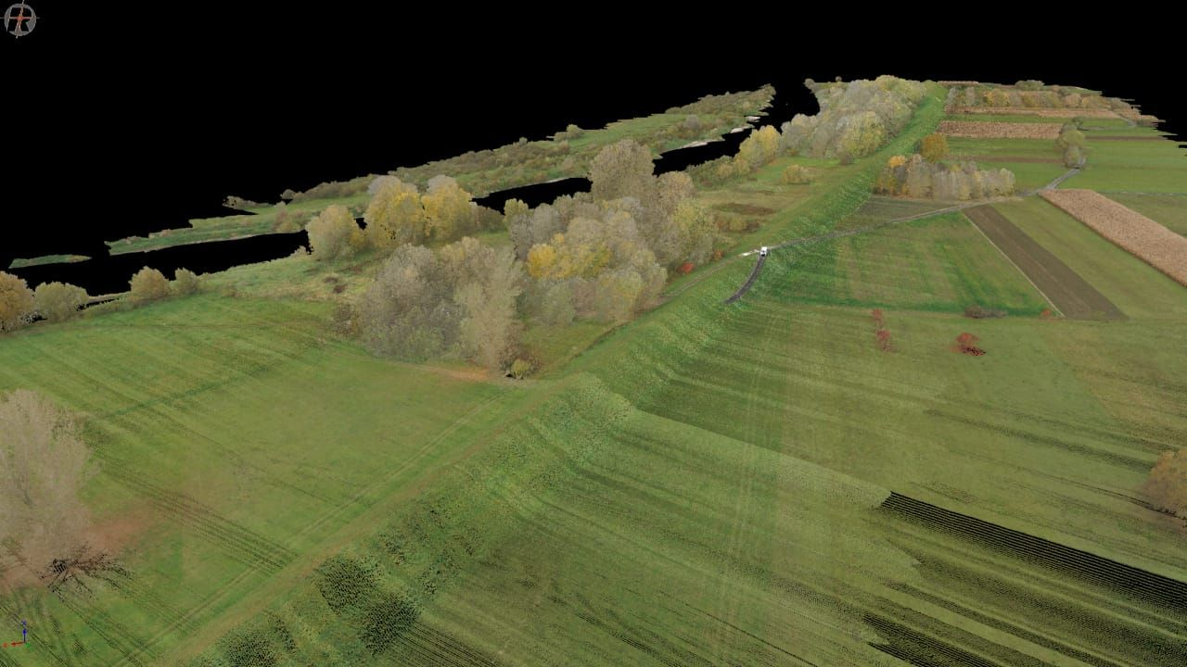
sensing the embakement

Slide 5
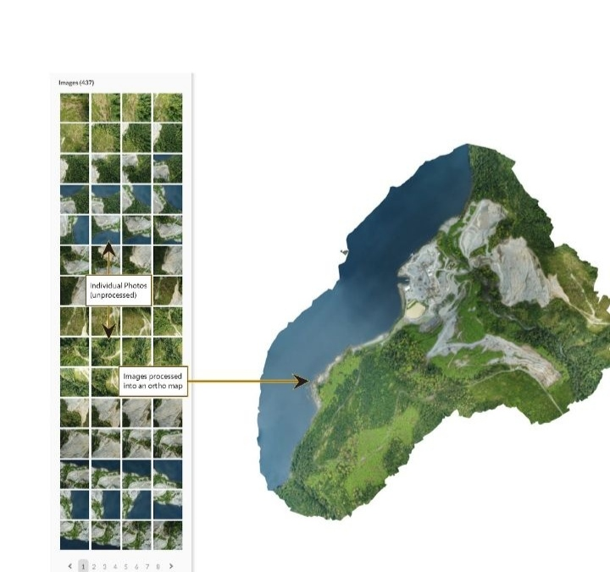
Orthomosaics

Slide 6
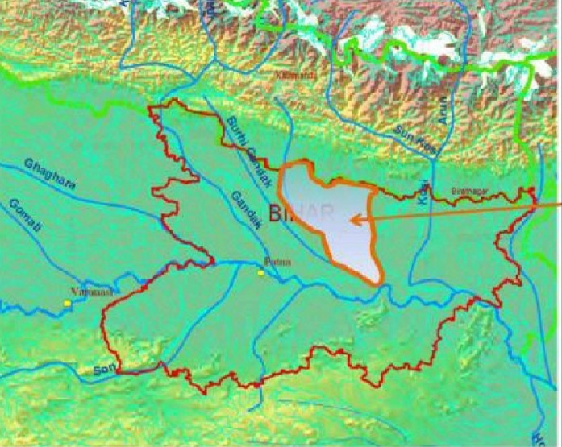

Slide 7
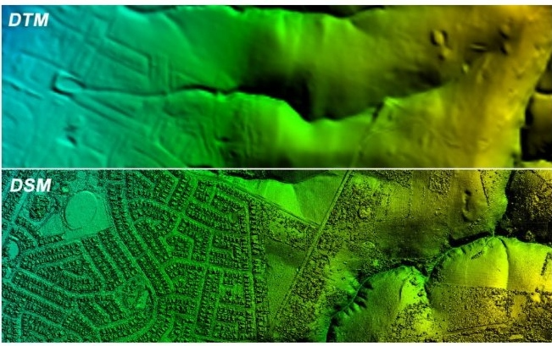
Digital surface model

Slide 8
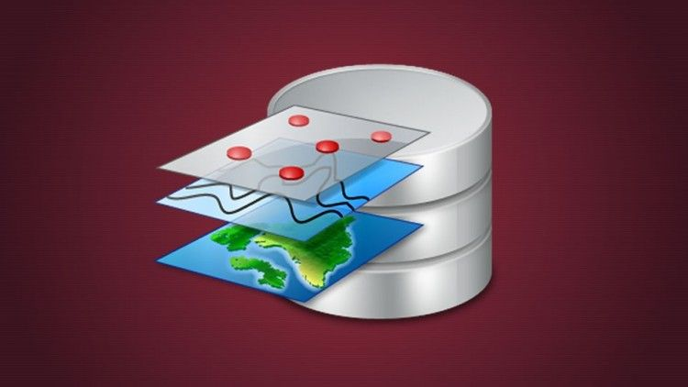
Spatial database

Slide 9
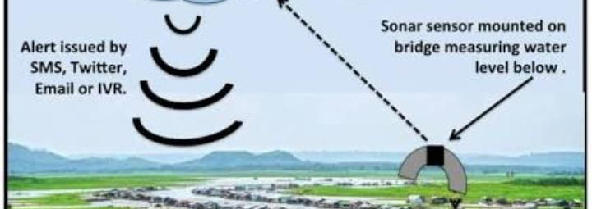

Slide 10
